Slide 1
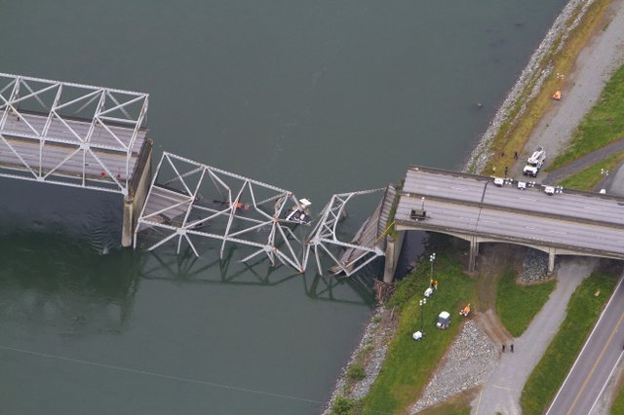
Gap Analysis
How we get from here .......to there

Slide 2
Definition
A technique used to determine what steps need to be taken in order to move from the current state to a desired future state.
Also called need-gap analysis, needs analysis or needs assessment

Slide 3
Using Gap Analysis
To conduct a Gap Analysis for our project, we need to follow these three steps:
Identify our Future State
Identify the Objectives we need to achieve
This gives us the “Future State” or where we want to be once we have completed your project
Example: How many Auxiliarist are needed to support the Sector during operations normal?

Slide 4
Using Gap Analysis
Analyze our current situation
For each objective in the process, analyze our current situation (this may be one objective or numerous objectives)
To do this consider the following:
Who has knowledge that we need?
Who do you need to speak with to get a clear pictures of the current situation?
Is the information in people’s head or documented?

Slide 5
Using Gap Analysis
To do this consider the following:
What is the best way to get the
information?
By brainstorming workshops?
Through one-on-one interviews
By reviewing documents
By observations
Other ways

Slide 6
Using Gap Analysis
Identify “How” you’ll Bridge the Gap
Once you know the future goals (end result)
Compare it with current situation (present state)
Now find the means to fill the Gap and build your plan or the delta

Slide 7
Building the Plans
Once you know the current and future states, analyzed the GAPS; now you need to write the plan to fill the gaps.
Use the appropriate amount of detail, but not over do it. Plans need to have sufficient information to get the objectives accomplished, no more.

Slide 8
Building the Plans
Plans need to be written to be “Living Documents” – Write a general overview of the current and future objectives and goals in the main body of the plan.
Write your details into annexes so that when a situation arises your members need to go to the annex to get the details of what they need to do.

Slide 9
Building the Plans
When you develop your plans use metrics where information is quantified ..it makes it easier and quicker to read.
Use general statements when metrics are not available.
Your assessment can be both quantitative and qualitative.

Slide 10
Gap Analysis Process
While the Gap Analysis Process seems very simple, don’t be fooled...it can take hours and hours of work and research to do it correctly.
Don’t underestimate how much work your Gap Analysis may involve!!

Slide 11
Gap Analysis Key Points
Compares current and future states
Doing a quality Gap Analysis will result in knowing your shortcomings or GAPS.
It will take many hours of research (reading CG plans), talking to Sector level staff members, working with your ASC and DIRAUX personnel, your Divisions to have the data to complete your plans.

Slide 12
Gap Analysis Key Points
Once you have all your information on the current state and on your future state (end resultant), you know the GAP in between, build your plan to meet the needs and fill the gaps to achieve your desired outcome.

Slide 13
District Level Support
5NR GAP ANALYSIS PLANNING WORKSHEET |  |  | 6. | Watchstanders | Facilities | AUX-FS | AUX-CFVE | AUC-CI | AUX-EU | AUX-TI | AUX-WM | UPV Examiner | In Port OOD | MAA Quarterdeck | Cont Planning Support | ICS Instructors | Admin Support | Yoga Instructor | IMT | ATON Verifiers | Fixed wing aircraft | Helos | Helo Ops Boat Crew | Helo Ops Coxswain | Tour Guides | Recruit Instructors | Physicans | Beach Access Watch | MWR Lucky Bag Sales | Graduation Support | 2. DATE PREPARED |  | 3. AUXILIARY DISTRICT
 |  |  | TYPES OF PERSONNEL |  |  |  |  |  |  |  |  |  |  |  |  |  |  |  |  |  |  |  |  |  |  |  |  |  |  |  | 10-Jul-15 |  | 5NR
1.INITIAL PLANNING
STEADY STATE/BACKFILL
4. DISTRICT ID | 5. SECTOR/AIR STATION/UNIT |  |  |  |  |  |  |  |  |  |  |  |  |  |  |  |  |  |  |  |  |  |  |  |  |  |  |  |  |  | 7. TOTAL SHORTFALLS | 8. TRAINING REQUIREMENTS MET | 9. TRAINING REQIREMENTS NOT MET | 10. COMMENTS
5 | Sector DELAWARE BAY Philadelphia, PA |  | REQ | 12 | 175 | 15 | 25 | 10 | 10 | 10 | 10 | 20 | 10 | 14 | 20 | 2 |  | 0 | 20 | 30 |  |  | 20 | 6
 |  |  | HAVE | 10 | 175 | 5 | 17 | 1 | 4 | 1 | 2 | 4 | 5 | 3 | 2 | 1 |  | 1 | 2 | 3 |  |  | 15 | 4
 |  |  | NEED | 2 | 0 | 10 | 8 | 9 | 6 | 9 | 8 | 16 | 5 | 11 | 18 | 1 |  | 0 | 18 | 27 |  |  | 5 | 2
5 | Air Station Atlantic City, NJ |  | REQ |  |  |  |  |  |  |  |  |  |  |  |  |  |  |  |  |  | 12 | 0
 |  |  | HAVE |  |  |  |  |  |  |  |  |  |  |  |  |  |  |  |  |  | 9 | 1
 |  |  | NEED |  |  |  |  |  |  |  |  |  |  |  |  |  |  |  |  |  | 3 | 0
5 | USCGC WILLIAM TATE Philadelphia, PA |  | REQ |  |  | 2 |  |  |  |  |  |  | 2
 |  |  | HAVE |  |  | 2 |  |  |  |  |  |  | 2
 |  |  | NEED |  |  | 0 |  |  |  |  |  |  | 0
5 | DIRAUX (5NR) Philadelphia, PA |  | REQ |  |  |  |  |  |  |  |  |  |  |  |  |  | 3 | 3
 |  |  | HAVE |  |  |  |  |  |  |  |  |  |  |  |  |  | 3 | 3
 |  |  | NEED |  |  |  |  |  |  |  |  |  |  |  |  |  | 0 | 0
FORCECOM Norfolk, VA | Training Center Cape May, NJ |  | REQ |  |  | 30 |  |  |  |  |  |  | 10 |  |  |  | 10 | 10 |  | 2 |  |  |  |  | 20 | 3 | 3 | 20 | 6 | 8
 |  |  | HAVE |  |  | 39 |  |  |  |  |  |  | 5 |  |  |  | 3 | 3 |  | 2 |  |  |  |  | 14 | 3 | 0 | 10 | 2 | 6
 |  |  | NEED |  |  | 0 |  |  |  |  |  |  | 5 |  |  |  | 7 | 7 |  | 0 |  |  |  |  | 6 | 0 | 3 | 10 | 4 | 2
LANTAREA NSFCC | Atlantic Strike Team Fort Dix, NJ |  | REQ |  |  |  |  |  |  |  |  |  |  |  |  |  | 7 | 7
 |  |  | HAVE |  |  |  |  |  |  |  |  |  |  |  |  |  | 7 | 7
 |  |  | NEED |  |  |  |  |  |  |  |  |  |  |  |  |  | 0 | 0
Special Missions Training Center | Deploymnet Training Detachment Fort Dix, NJ |  | REQ |  |  |  |  |  |  |  |  |  |  |  |  |  | 4 | 4
 |  |  | HAVE |  |  |  |  |  |  |  |  |  |  |  |  |  | 4 | 4
 |  |  | NEED |  |  |  |  |  |  |  |  |  |  |  |  |  | 0 | 0
USCGHQ | Recruiting Office Philadelphia, PA |  | REQ |  |  |  |  |  |  |  |  |  |  |  |  |  | 5 | 5
 |  |  | HAVE |  |  |  |  |  |  |  |  |  |  |  |  |  | 2 | 2
 |  |  | NEED |  |  |  |  |  |  |  |  |  |  |  |  |  | 3 | 3
 |  |  | REQ
 |  |  | HAVE
 |  |  | NEED
 |  |  | REQ
 |  |  | HAVE
 |  |  | NEED
 |  | 11. TOTAL PERSONNEL REQUIRED |  | 12 | 175 | 47 | 25 | 10 | 10 | 10 | 10 | 20 | 22 | 14 | 20 | 2 | 29 | 29 | 20 | 32 | 12 | 0 | 20 | 6 | 20 | 3 | 3 | 20 | 6 | 8
 |  | 12. TOTAL PERSONNEL ON HAND |  | 10 | 175 | 46 | 17 | 1 | 4 | 1 | 2 | 4 | 12 | 3 | 2 | 1 | 19 | 20 | 2 | 5 | 9 | 1 | 15 | 4 | 14 | 3 | 0 | 10 | 2 | 6
 |  | 13. TOTAL PERSONNEL NEEDED |  | 2 | 0 | 2 | 8 | 9 | 6 | 9 | 8 | 16 | 10 | 11 | 18 | 1 | 10 | 10 | 18 | 27 | 3 | 0 | 5 | 2 | 6 | 0 | 3 | 10 | 4 | 2

Slide 14
Gap Analysis
Practical Exercise
See Tab M in your Notebook

Slide 15
Scenario

Slide 16
Objectives
Explain the Hurricane Preparedness Process
Explain the Hurricane Response Process
Explain the Hurricane Recovery Process
Notes:
This exercise is designed to establish a learning environment for players to exercise the plans, policies, and procedures as they pertain to hurricanes.

Slide 17
HIATUSPORT
Look at where the following things are located.
Foggy Marsh
Anchorage sites
Route 17 Bridge
Location of Station Oyster Bay
Location of Thumbs Point

Slide 18
HIATUSPORT
Located in Hiatus County on eastern shore of Delaware
Same Latitude as Washington D.C.
City Population 500,000
County Population 1,250,000
Located on the Mouth of Sangria River
Shipping is an important industry

Slide 19
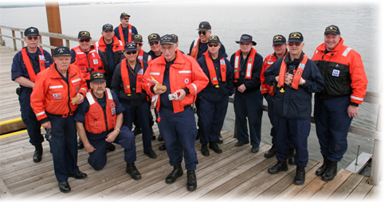
Assets
Coast Guard Sector Hiatusport
Co-located with Station Thumb’s point
118 personnel assigned (25 officers, 85 enlisted, 8 civilians)
Standard Sector Model command structure
Five sub units

Slide 20
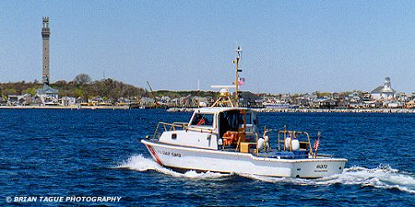
Station Thumbs Point
30 enlisted personnel
4 boats (CG41397, CG 47603, CG 25212, CG 25213)
Five Auxiliary facilities are available
One dually truck

Slide 21
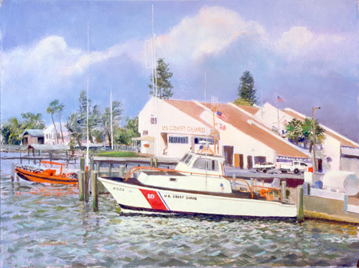
Station Oyster Bay
Located 25NM down the coast from Hiatusport
4 boats (CG 47703, CG 41503, CG 41501, CG 25215)
33 enlisted personnel
One dually truck
Five Auxiliary Facilities

Slide 22
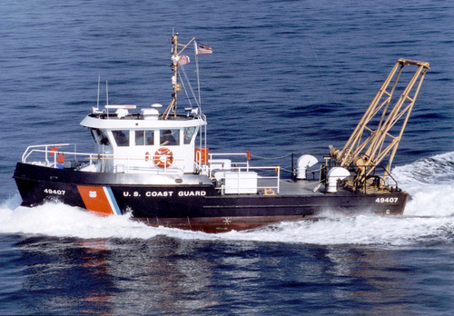
Aids to Navigation Team Hiatusport
6 enlisted personnel
49 foot BUSL aids to Navigation boat

Slide 23
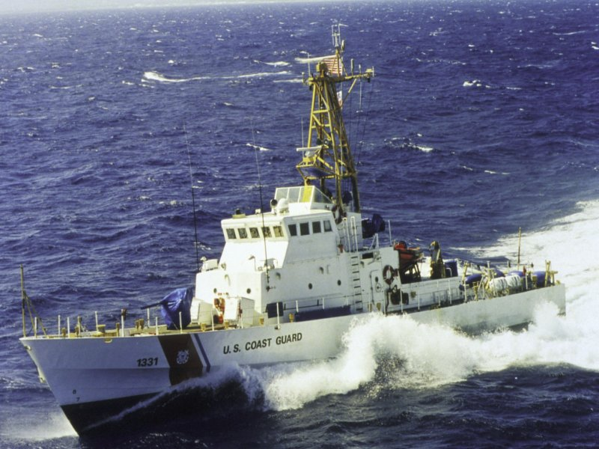
USCGC GOVERNOR’S ISLAND
Hull # is WPB 6213
110’patrol boat
Based out of Sector Hiatusport
Crew of 16 (1 officer and 15 enlisted)
Carries a RHIB

Slide 24
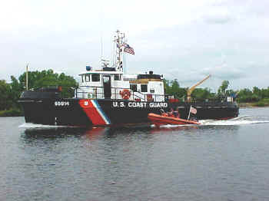
USCGC SHACKLE
Hull # WYTL 65278
Based out of Sector Hiatusport
65 foot Harbor Tug
Six man Crew

Slide 25
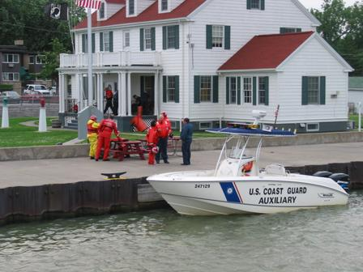
USCG Auxiliary 2-4
32 members
1 base VHF marine radio
6 platforms
503
684
412
279
845
652

Slide 26
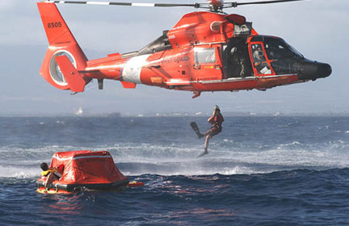
USCG AIRSTA Atlantic City
Takes 45 minutes to arrive at Sector Hiatusport
3 HH-65 aircraft with #’s 6547, 6501, 6509
8 qualified pilots
2 CWO’s and 24 enlisted personnel

Slide 27
Marine Safety Security Team
MSST 91150 established in Hiatusport
Co-located with Sector at Thumbs point
Has 4 vessels: CG 25114, CG 213894, CG 25136, CG 25118)
Two dive teams
Two dog teams
Shore side security team
4 GSA vehicles

Slide 28
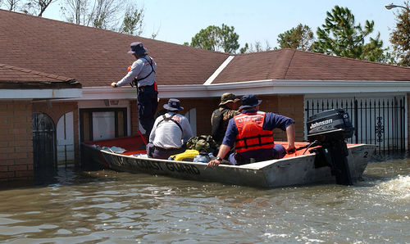
Support from other Agencies
Federal
FEMA
National Weather Service
Customs Service
Environmental Protection Agency
Maritime Administration
U.S. Army Corp of Engineers
Naval Operations Base Hiatusport
Federal Aviation Administration

Slide 29
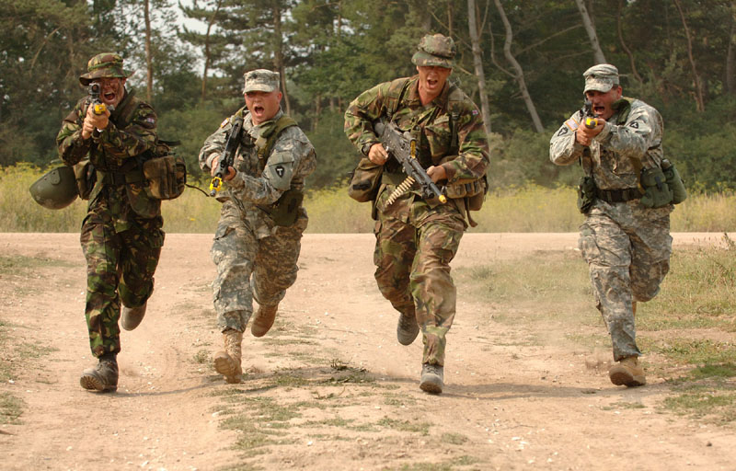
Support from Other Agencies
State
Delaware Marine Fisheries
Delaware State Police
Delaware National Guard

Slide 30
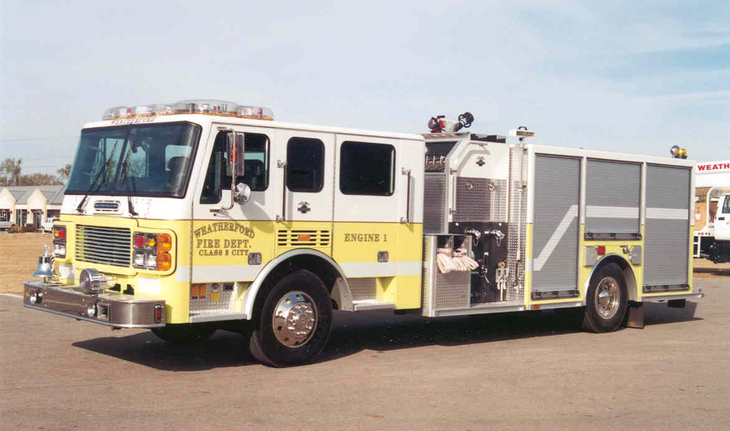
Support from Other Agencies
Local
Hiatusport Sherriff Office
Hiatusport City Police
Hiatusport City Fire Department
Hiatusport County Fire Department
Hiatusport Bay Bridge and Tunnel Authority
Port Authority & Passenger Terminal
City/ County EOC
Memorial Hospital
Hiatusport County EMS
American Red Cross

Slide 31
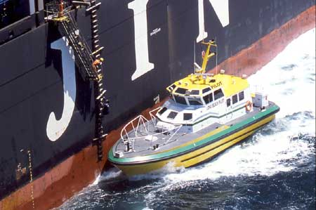
Support from Other Agencies
Private
Delaware Pilots Association
Ron’s towing
Joe’s Bunkering Services
Clean Rivers Inc
Coral Marine Salvage
Shorty’s Tug and Barge Service

Slide 32
Notes:
Before we move on, are there any questions?

