Slide 1
District Incident Management and Preparedness
Bob Tippett
DSO-IM, 8WR
Dir-Qd

Slide 2
Incident Management and Preparedness (IM)
IT’S A NEW BALLGAME !!
CHANGE IN OUR CONCEPT OF OPERATIONS. (Planning vs. Reacting)
IT IS A NEW PARADIGM.
ZIG ZIGLER put it this way - “ WE NEED TO GET RID OF THE STINKING THINKING AND DO A CHECK UP FROM THE NECK UP.”

Slide 3
IM – USCG/Auxiliary
Vice Commandant stated 2 ½ years ago-change or there will be no funding.
Sequestration – lack of funding.
Requires more planning/change.

Slide 4
IM – USCG/Auxiliary
November 2014 - Incident Management and Preparedness came of age in the Auxiliary.
Preparedness is now a mainstay for the future.
Mission enhancement for the future – Training to support the AD in the future.

Slide 5
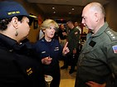
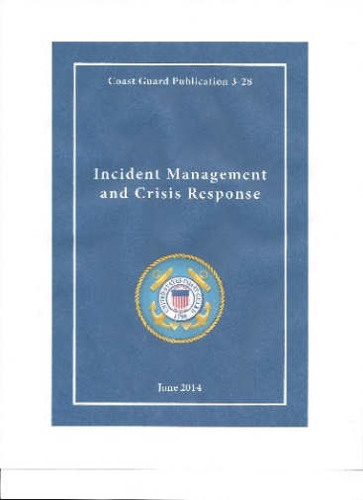
IM - USCG
IM started changing in USCG following DWH.
Consolidated IM into its own Directorate.
Lead by RADM(Ret) Mary Landry

Slide 6
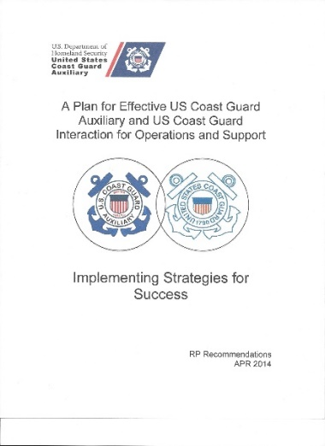
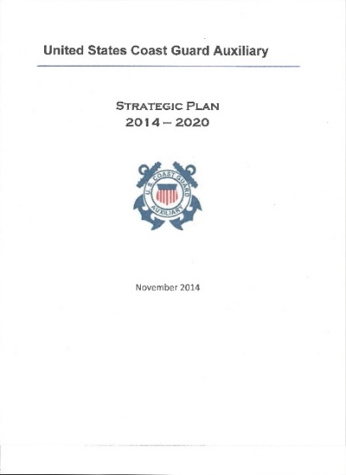
IM - Auxiliary
NACO – Direction for the future – more planning.
S4S. [National website]
National Strategic Plan.
Guidance for the future. (5 Yrs. for Planning)

Slide 7
Incident Management New Directions
Incident Management & Preparedness Directorate [Q] – New Directions.
A top priority of the National Strategic Plan is a total GAP Analysis review of CG needs vs. Auxiliary support capabilities.
New National level reporting requirements concerning District readiness. (PAL)

Slide 8
New Directions
Specific timelines have been established to make contact w/ CG units and Sectors for review of CG needs .
New District Level Staff Position developed to assist DCO’s in their preparedness efforts.

Slide 9
New Directions
DSO-IM works closely with ASC’s and other DSO’s to meet the readiness planning requirements.
GAP Analysis needs are to be determined and completed by 30 June 2016 with a report to the NEXCOM.

Slide 10
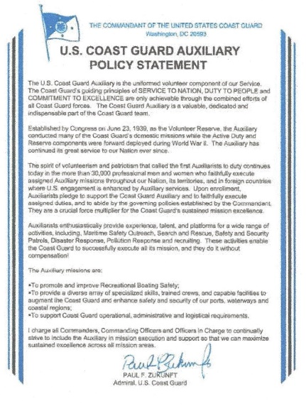
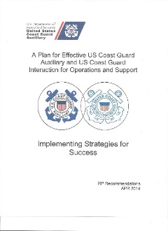
How Does It Apply to me?
To promote and improve RBS
To provide a diverse array of specialized skills, trained crews, and capable facilities to augment the Coast Guard and enhance safety and security of our ports, waterways and coastal regions
To support Coast Guard operational, administrative and logistical requirements
Means more planning and less reaction.
More deliberate actions.
Review of S4S – Auxiliary Strategic Plan 2014-2020
“ I charge all Commanders, Commanding Officers and Officers in Charge to continually strive to include the Auxiliary in mission execution and support so that we can maximize sustained excellence across all mission areas.”

Slide 11
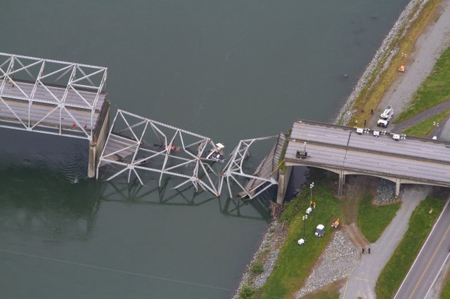
Gap Analysis
How we get from here .......to there
& Why are doing it?

Slide 12
Incident Management and Preparedness
One Plan, One Response, One Coast Guard.
Find the needs, fill the needs, plan for the shortfalls.
Planning for all events.

Slide 13
FY15 Coast Guard Auxiliary Slices of Budget and Workforce
Auxiliary
30K (35%)
Coast Guard
Workforce
85K
Civilian
8K (9%)
Active Duty
40 K (48%)
Reserve
7K (8%)
Notes:
More than 1/3 of the CG workforce is supported with close to ¼ of 1 percent of the CG’s OE budget.
Widely accepted ROI of at least 12:1, likely more as many Aux activities go unreported. That 12:1 ROI is both a source of pride and also a source of contention – members often ask “why would the CG cut us more?”
There is a neg FY14 RP that will eliminate 8 regional DIRAUX staff positions.
Essential FY13 elements:
- DIRAUX office budgets (AFC-30) $2.68M
- CG-BSX-1 office budget (AFC-30) $0.86M
- PPE (AFC-30) $1.17M
- Patrol expenses/fuel (AFC-30) $2.42M
- Standard Aux Maintenance Allowance (AFC-30) $1.48M
- Catastrophic claims (AFC-30) $0.10M
- C-school training (AFC-56) $0.71M
- Standard Personnel Costs (DIRAUX / BSX-1 staff) $9.40M
================================================
total $18.82M

Slide 14
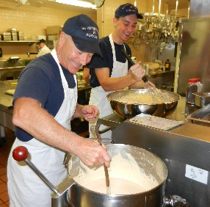
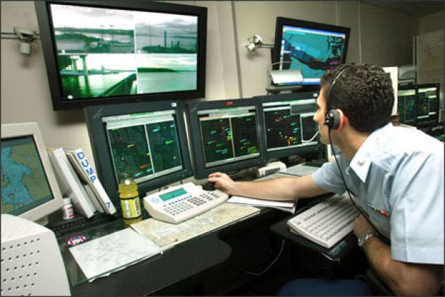
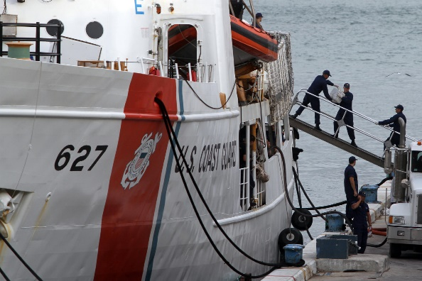
Incident Management and Preparedness
Develop ways to support the CG during:
Steady State (Day-to-Day).
Backfill for deployments.
Surge Operations.
Targeted Augmentation.

Slide 15
District Level Support
New DSO/ADSO positions to help the DCO accomplish the mission.
Requires face-to-face with the Sector Leadership by the ASC/ADSO’s to determine the needs of the CG. [To boat station/Air station levels]
Long-Range Planning effort to incorporate the Auxiliary more into the CG Planning.
Developing more/better ties with our AD partners.
Educate the AD on what we are capable of doing for them. [Sector NC example]

Slide 16
GAP Analysis Timelines
Steady State – July 2015 [Problems with the response results from most Districts, we need to fix the shortfalls. Steady State is baseline]
Backfill to Sector units – 30 March 2016
Surge Operations – 30 April 2016
Targeted Augmentation – 30 May 2016
Final report to NEXCOM and presented at NACON – Aug 2016.

Slide 17
District Level Support
5NR GAP ANALYSIS PLANNING WORKSHEET |  |  | 6. | Watchstanders | Facilities | AUX-FS | AUX-CFVE | AUC-CI | AUX-EU | AUX-TI | AUX-WM | UPV Examiner | In Port OOD | MAA Quarterdeck | Cont Planning Support | ICS Instructors | Admin Support | Yoga Instructor | IMT | ATON Verifiers | Fixed wing aircraft | Helos | Helo Ops Boat Crew | Helo Ops Coxswain | Tour Guides | Recruit Instructors | Physicans | Beach Access Watch | MWR Lucky Bag Sales | Graduation Support | 2. DATE PREPARED |  | 3. AUXILIARY DISTRICT
 |  |  | TYPES OF PERSONNEL |  |  |  |  |  |  |  |  |  |  |  |  |  |  |  |  |  |  |  |  |  |  |  |  |  |  |  | 10-Jul-15 |  | 5NR
1.INITIAL PLANNING
STEADY STATE/BACKFILL
4. DISTRICT ID | 5. SECTOR/AIR STATION/UNIT |  |  |  |  |  |  |  |  |  |  |  |  |  |  |  |  |  |  |  |  |  |  |  |  |  |  |  |  |  | 7. TOTAL SHORTFALLS | 8. TRAINING REQUIREMENTS MET | 9. TRAINING REQIREMENTS NOT MET | 10. COMMENTS
5 | Sector DELAWARE BAY Philadelphia, PA |  | REQ | 12 | 175 | 15 | 25 | 10 | 10 | 10 | 10 | 20 | 10 | 14 | 20 | 2 |  | 0 | 20 | 30 |  |  | 20 | 6
 |  |  | HAVE | 10 | 175 | 5 | 17 | 1 | 4 | 1 | 2 | 4 | 5 | 3 | 2 | 1 |  | 1 | 2 | 3 |  |  | 15 | 4
 |  |  | NEED | 2 | 0 | 10 | 8 | 9 | 6 | 9 | 8 | 16 | 5 | 11 | 18 | 1 |  | 0 | 18 | 27 |  |  | 5 | 2
5 | Air Station Atlantic City, NJ |  | REQ |  |  |  |  |  |  |  |  |  |  |  |  |  |  |  |  |  | 12 | 0
 |  |  | HAVE |  |  |  |  |  |  |  |  |  |  |  |  |  |  |  |  |  | 9 | 1
 |  |  | NEED |  |  |  |  |  |  |  |  |  |  |  |  |  |  |  |  |  | 3 | 0
5 | USCGC WILLIAM TATE Philadelphia, PA |  | REQ |  |  | 2 |  |  |  |  |  |  | 2
 |  |  | HAVE |  |  | 2 |  |  |  |  |  |  | 2
 |  |  | NEED |  |  | 0 |  |  |  |  |  |  | 0
5 | DIRAUX (5NR) Philadelphia, PA |  | REQ |  |  |  |  |  |  |  |  |  |  |  |  |  | 3 | 3
 |  |  | HAVE |  |  |  |  |  |  |  |  |  |  |  |  |  | 3 | 3
 |  |  | NEED |  |  |  |  |  |  |  |  |  |  |  |  |  | 0 | 0
FORCECOM Norfolk, VA | Training Center Cape May, NJ |  | REQ |  |  | 30 |  |  |  |  |  |  | 10 |  |  |  | 10 | 10 |  | 2 |  |  |  |  | 20 | 3 | 3 | 20 | 6 | 8
 |  |  | HAVE |  |  | 39 |  |  |  |  |  |  | 5 |  |  |  | 3 | 3 |  | 2 |  |  |  |  | 14 | 3 | 0 | 10 | 2 | 6
 |  |  | NEED |  |  | 0 |  |  |  |  |  |  | 5 |  |  |  | 7 | 7 |  | 0 |  |  |  |  | 6 | 0 | 3 | 10 | 4 | 2
LANTAREA NSFCC | Atlantic Strike Team Fort Dix, NJ |  | REQ |  |  |  |  |  |  |  |  |  |  |  |  |  | 7 | 7
 |  |  | HAVE |  |  |  |  |  |  |  |  |  |  |  |  |  | 7 | 7
 |  |  | NEED |  |  |  |  |  |  |  |  |  |  |  |  |  | 0 | 0
Special Missions Training Center | Deploymnet Training Detachment Fort Dix, NJ |  | REQ |  |  |  |  |  |  |  |  |  |  |  |  |  | 4 | 4
 |  |  | HAVE |  |  |  |  |  |  |  |  |  |  |  |  |  | 4 | 4
 |  |  | NEED |  |  |  |  |  |  |  |  |  |  |  |  |  | 0 | 0
USCGHQ | Recruiting Office Philadelphia, PA |  | REQ |  |  |  |  |  |  |  |  |  |  |  |  |  | 5 | 5
 |  |  | HAVE |  |  |  |  |  |  |  |  |  |  |  |  |  | 2 | 2
 |  |  | NEED |  |  |  |  |  |  |  |  |  |  |  |  |  | 3 | 3
 |  |  | REQ
 |  |  | HAVE
 |  |  | NEED
 |  |  | REQ
 |  |  | HAVE
 |  |  | NEED
 |  | 11. TOTAL PERSONNEL REQUIRED |  | 12 | 175 | 47 | 25 | 10 | 10 | 10 | 10 | 20 | 22 | 14 | 20 | 2 | 29 | 29 | 20 | 32 | 12 | 0 | 20 | 6 | 20 | 3 | 3 | 20 | 6 | 8
 |  | 12. TOTAL PERSONNEL ON HAND |  | 10 | 175 | 46 | 17 | 1 | 4 | 1 | 2 | 4 | 12 | 3 | 2 | 1 | 19 | 20 | 2 | 5 | 9 | 1 | 15 | 4 | 14 | 3 | 0 | 10 | 2 | 6
 |  | 13. TOTAL PERSONNEL NEEDED |  | 2 | 0 | 2 | 8 | 9 | 6 | 9 | 8 | 16 | 10 | 11 | 18 | 1 | 10 | 10 | 18 | 27 | 3 | 0 | 5 | 2 | 6 | 0 | 3 | 10 | 4 | 2

Slide 18
District Incident Management and Preparedness
New roles, new programs, better support to the Coast Guard.
Better information for the Auxiliarist that needs to deploy.

Slide 19
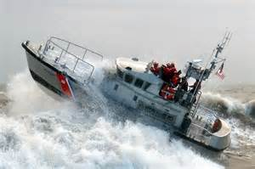
District Incident Management and Preparedness
Information and guidance for better support to our customer.
Better support to our membership.

Slide 20
District Incident Management and Preparedness
Q & A

Slide 21
