Slide 1
N-Train 2016 U.S. COAST GUARD AUXILIARY AND THE FUTURE
Robert Tippett
Deputy Director
Incident Management and Preparedness Directorate

Slide 2
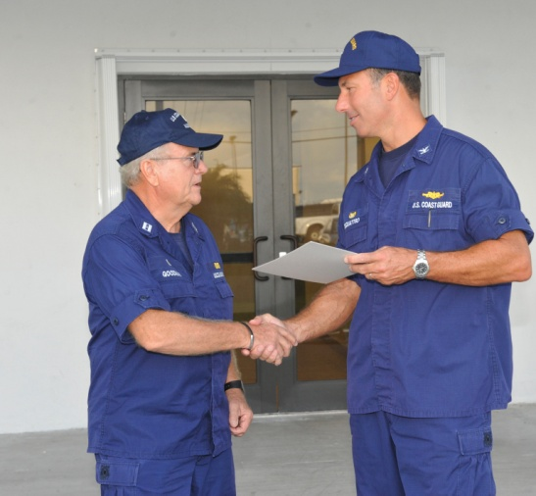
Goals and Objectives
GOALS:
DEVELOP A UNDERSTANDING OF THE
AUXILIARY INCIDENT MANAGEMENT
PROGRAM & GAP ANALYSIS.
DEVELOP A UNDERSTANDING OF THE GAP ANALYSIS PROCESS, ITS PURPOSE AND THE RELATIONSHIP BETWEEN DISTRICTS, NATIONAL AND ACTIVE DUTY.
UNDERSTAND THE RELATIONSHIPS BETWEEN THE DCO/DCOS AND DSO-IM, THE ASC, THEIR DUITES AND RESPONIBILITIES AS RELATED TO INCIDENT MANAGEMENT.

Slide 3
Goals and Objectives
Goals and Objectives
GOALS (CON’T):
DEVELOP AN UNDERSTANDING OF THE GAP ANAYLSIS AND WHAT THE PROJECT OBJECTIVES ARE FOR NOW AND THE FUTURE OF THE AUXILIARY.
LEARN WHAT STEPS NEED TO BE ACCOMPLISHED TO SUCCESSFULLY COMPLETE THE GAP ANALYSIS.
DEVELOP AN UNDERSTANDING OF THE REQUIRED IMPORTANCE THAT NEEDS TO BE PLACED ON THIS PROJECT FOR SUCCESSFUL COMPLETION.

Slide 4
Goals and Objectives
OBJECTIVES:
SHOW THE ALIGNMENT OF THE GAP ANALYSIS PROJECT WITH THE NATIONAL STRATEGIC PLAN.
REVIEW THE STRATEGIES FOR SUCCESS PLAN (S4S) AND HOW IT RELATES TO THE GAP ANALYSIS.
REVIEW THE DUTIES AND RESPONSIBILITIES OF THE DSO-IM AND ASC POSTIONS AND THEIR RELATIONSHIP TO THE GAP ANALYSIS.
REVIEW THE NEED FOR THE DSO-IM & ASC TO CLEARLY UNDERSTAND THE GAP ANALYSIS PROCESS.

Slide 5
Goals and Objectives
OBJECTIVES:
REVIEW AND UNDERSTAND THE RELATIONSHIP WITH OTHER STAFF POSITIONS, CG DISTRICT, SECTORS AND OTHERS.
DEVELOP AN UNDERSTANDING OF CONTINGENCY PLANNING AT SECTOR/AUXILIARY DISTRICT LEVEL.
DEVELOP AN UNDERSTANDING OF
“GAP” ANALYSIS AND WHY IT IS
IMPORTANT TO THE AUXILIARY/CG.

Slide 6
Goals and Objectives
UNDERSTAND HOW TO MANAGE AND USE “SKILLS BANK”
UNDERSTAND HOW TO MANAGE AND USE EVERBRIDGE
DEVELOP AN UNDERSTANDING OF THE “IRIS” PROGRAM.

Slide 7
Notes:
Before we close, are there any questions?

