Slide 1
Incident Management Tabletop Exercise
N-Train 2016

Slide 2
Training Objective
The following scenario has been designed to asses the response of your District / Region to a simulated event.
Through this exercise we hope to:
Consider what actions we anticipate taking in response to an incident
Consider what resource requirements and challenges would look like
Identify opportunities to fill planning gaps and improve our capability
The overall goal is to maximize the resiliency of people and resources to carry out Auxiliary missions during critical events.

Slide 3
Exercise Guidance
This is only a training exercise!
Let’s keep the experience fun, positive, and constructive
There are no “correct” answers – we measure by effectiveness
One size does not fit all – consider the needs of your AOR!
Listen to other participants, and consider their answers with respect to yours. Emergency Managers borrow ideas all the time.
All thoughts and ideas are encouraged. Don’t be afraid to speak up!

Slide 4
Exercise Structure
This is a table top exercise, which is meant to stimulate group discussion based on situations presented in the scenario
You will be given a set amount of time and asked to form responses to questions during each of three phases of exercise play
After your group forms its responses, we will share information as a group so that we can learn from each other
The scenario is based on an event with major impact to your AOR
While the scenario is realistic, it is an exercise and some artificiality may exist. Don’t get hung up on the details: focus on the big picture.

Slide 5
Incident Management: STARTEX

Slide 6
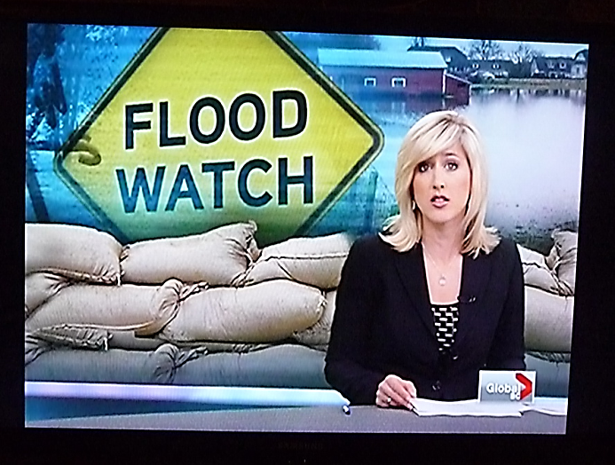
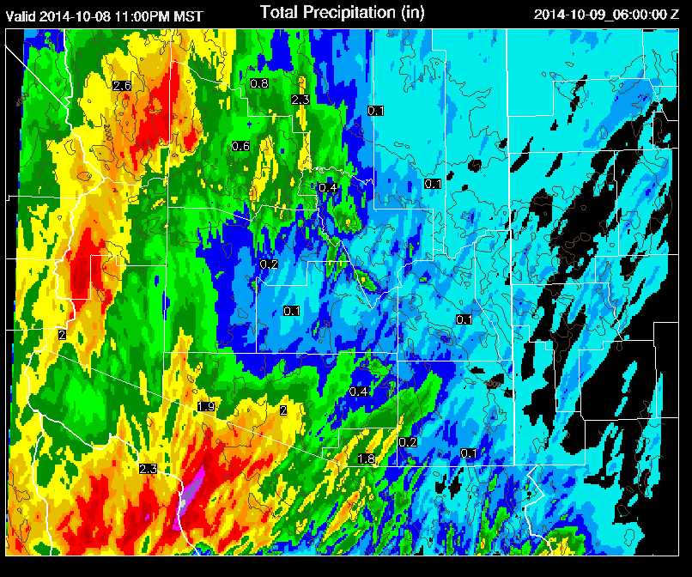
Exercise Phase I
TUESDAY: 1000 HOURS LOCAL TIME
Heavy rains over the past several days have saturated the ground, leaving waterways in the area at dangerously high levels.
The National Weather Service (NWS) issues a flood watch for a large portion of your district/region.
The forecast calls for additional heavy rainfall, perhaps as much as 4-6 inches during the next 72 hours.

Slide 7
Phase I Questions
Who is responsible for situational awareness / incident monitoring?
How would leadership be alerted to a potential incident?
What immediate concerns do you have given the flood watch?
What decisions need to be made at this time, and who has the authority to make them?
What existing plans, procedures, or standing orders are currently in place that may apply to the current situation?
With whom are you communicating at this point, and what are you telling / asking them?

Slide 8
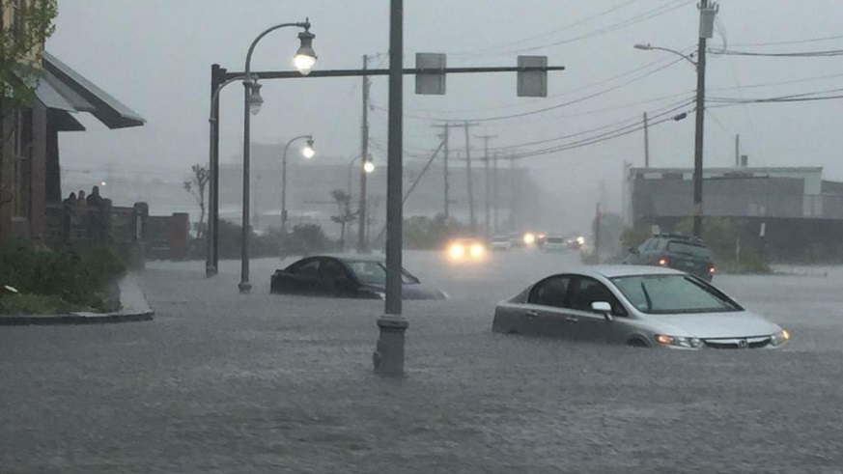
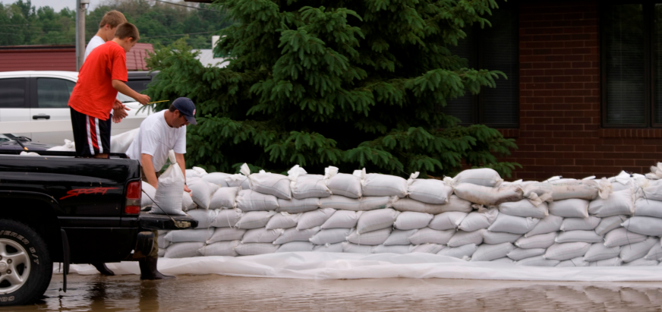
Exercise Phase II
THURSDAY: 1200 HOURS LOCAL TIME
As the rain continues to fall, the NWS issues a flood warning for a large portion of your district/region and estimates that major flooding will occur in 12 hours.
Some communities are issuing voluntary evacuations along key waterways.
Port operations are being impacted, and flood fighting efforts such as sandbagging are underway in traditionally flood prone areas.

Slide 9
Phase II Questions
Based on the updated information, have your concerns changed?
With whom and what information are you communicating?
Are Auxiliary missions continuing? What if any mission capability do you expect from your members at this time?
Do you have a process in place to account for the safety and well-being of your members?
What is the Auxiliary’s role in the community flood fighting efforts, if any?

Slide 10
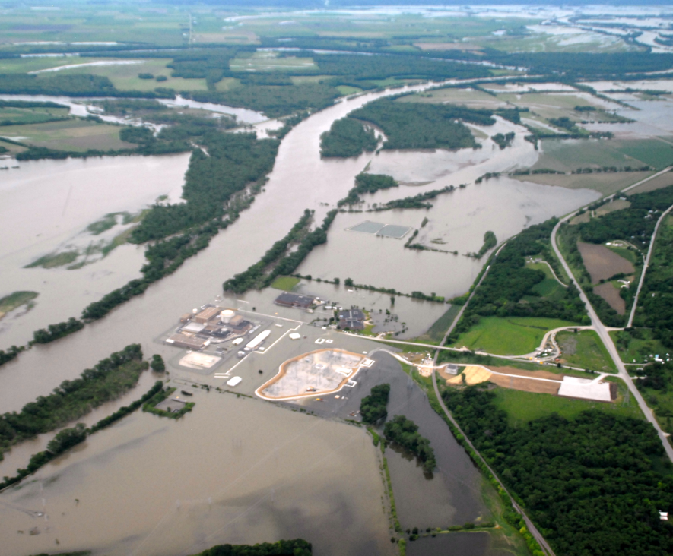
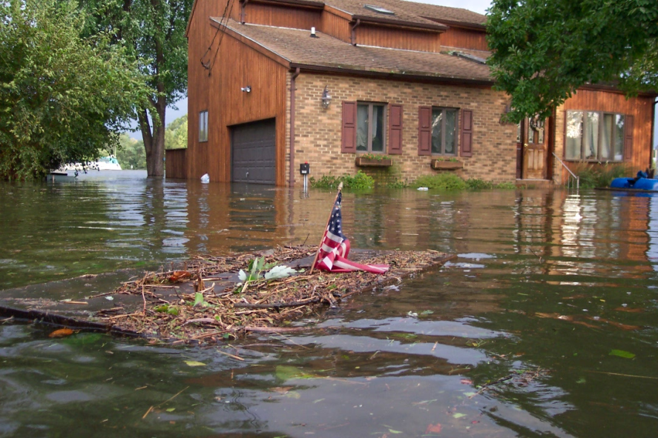
Exercise Phase III
SUNDAY: 1000 HOURS LOCAL TIME
Floodwaters have crested and are beginning to recede from much of the area.
Roadways are slowly beginning to open and residents who evacuated from impacted areas are returning to survey the damage.
Schools have announced they will be closed on Monday in many places, and there are still shelters opened and power outages across a large area.

Slide 11
Phase III Questions
What communications with the membership and leadership should occur at this point?
What are the district/region’s priorities for re-establishing operational capability to perform missions?
What is the Auxiliary’s role in supporting the Coast Guard and the community during recovery?
How is the Auxiliary prepared to provide support or assistance to those members who have been affected by physical loss, anxiety, or stress associated with the event?

Slide 12
Incident Management: ENDEX

Slide 13
Hotwash Discussion
What strengths in your preparedness were identified?
What potential gaps were exposed?
What unanticipated issues arose during the exercise?
Any new ideas or recommendations for improvement?

Slide 14
Next Steps
Exercises are how we learn lessons and strengthen our readiness outside of a real incident.
Identify the top three improvement priorities based on your experiences in this exercise
Assign each priority to a responsible individual
Set a date for reporting back with recommended actions

